Slide 1


5/7/2024
Urban Ocean
Marine Litter Assessment

Slide 2





Team
Shreya
Trevor
Stephanie
Tianxiao
Xiaofan
PM + App
Github + Report
Model + Report
Model
App

Slide 3
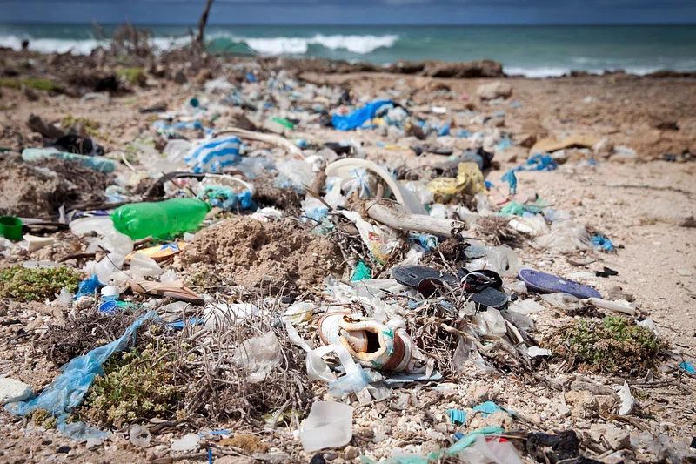

Marine plastics by the Numbers
11 million
60%
tons of plastic end up in the ocean annually
of examined fish digested microplastic
Trash needs to be manually removed to when it enters the ocean
Source

Slide 4
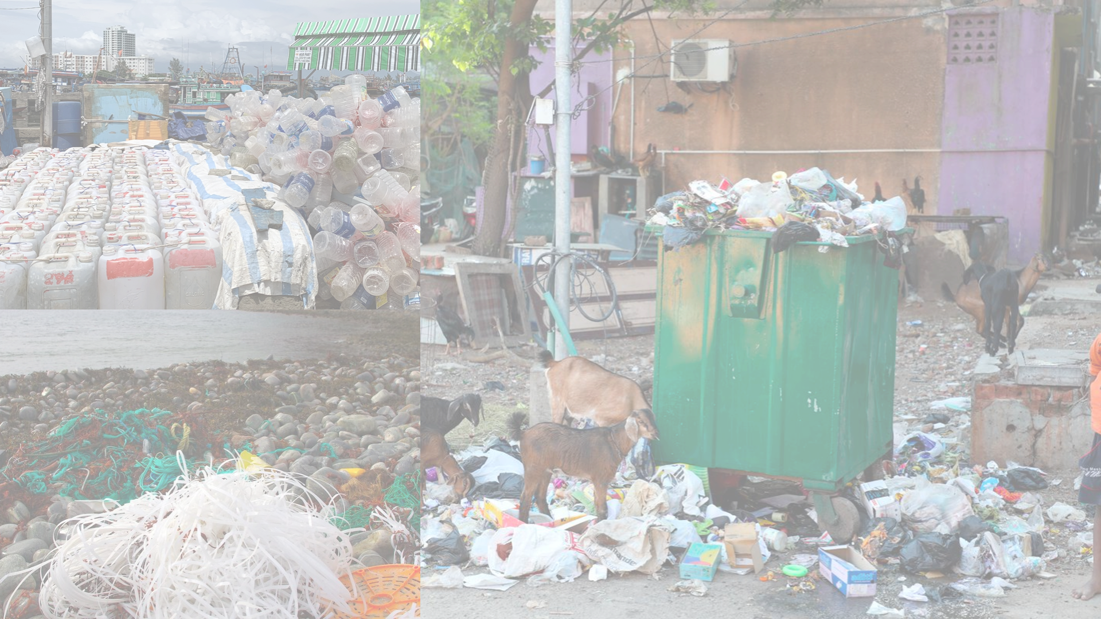



Urban Litter to Marine Trash
Cities are one of the primary sources of this accumulation
Wind and water carry urban trash to oceans
Illegal dumping, lack of sanitation infrastructure, single-use plastic
Source

Slide 5





Project Partners
Project Director: Daniel Padilla Ochoa
Director, International Plastics Program - Ocean Conservancy: Edith Checchini
University. of Georgia: Prof. Jenna Jambeck, Ph.D.
Practicum Professors:
Michael Fichman and Matthew Harris

Slide 6
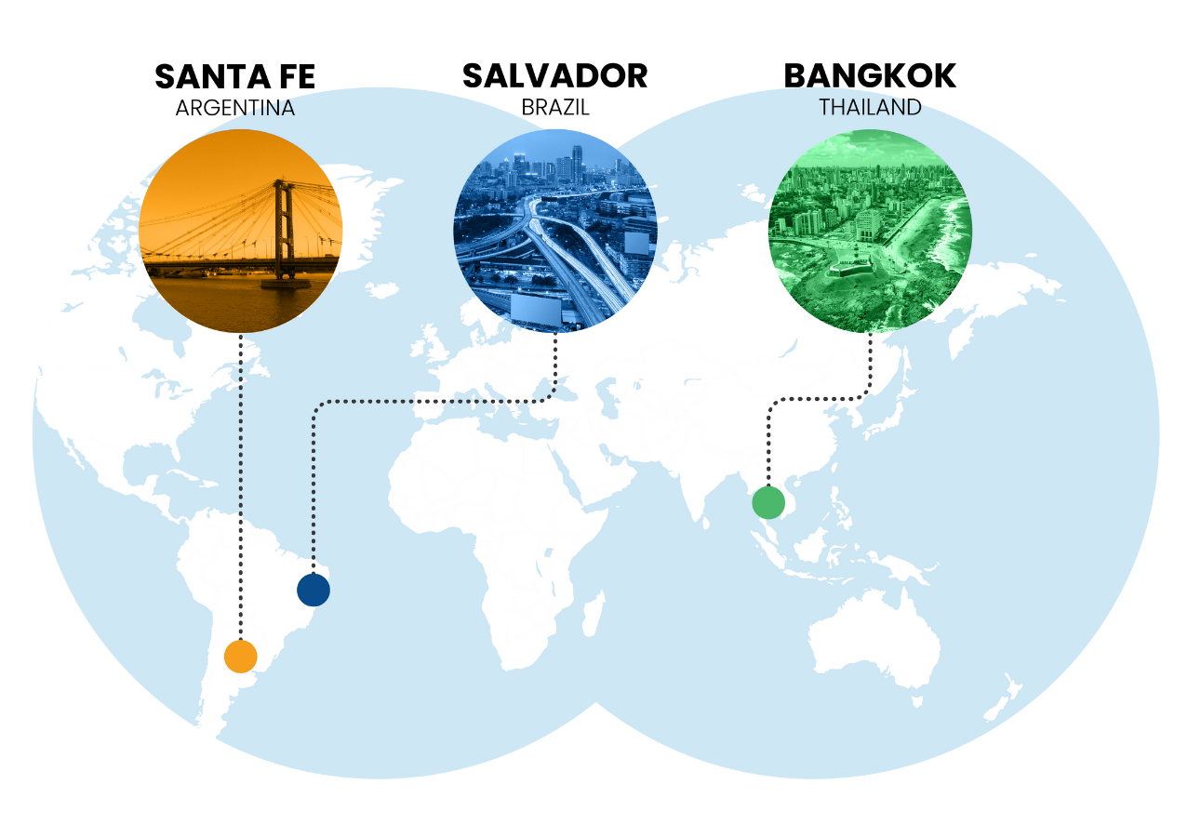
Zero Waste Pilots
Mobilize cleanup campaigns
City-by-City research on sanitation systems and trash-situation
Consult with stakeholders directly to create alternative solutions for current needs

Slide 7
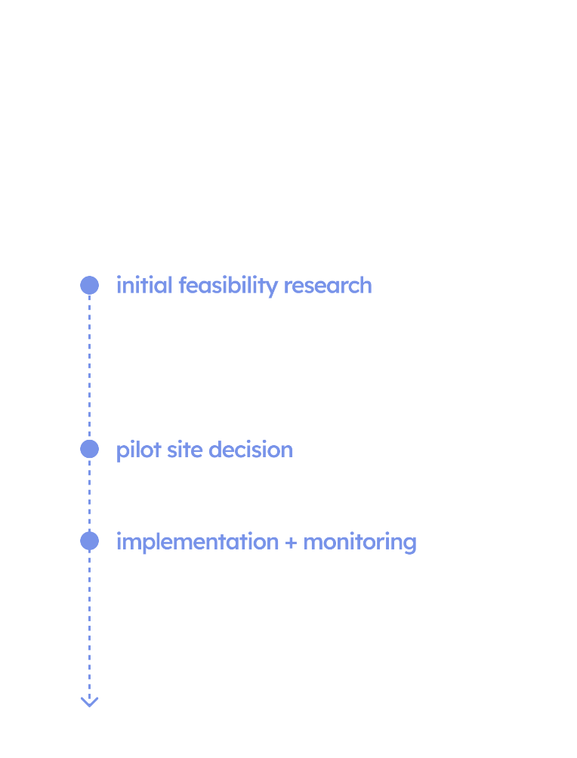
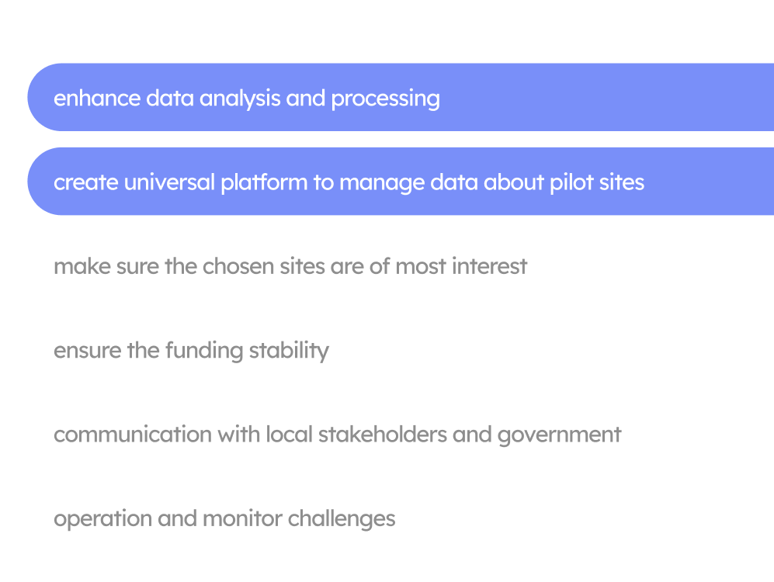
Why Us?
Urban Ocean workflow challenges
Our intervention

Slide 8
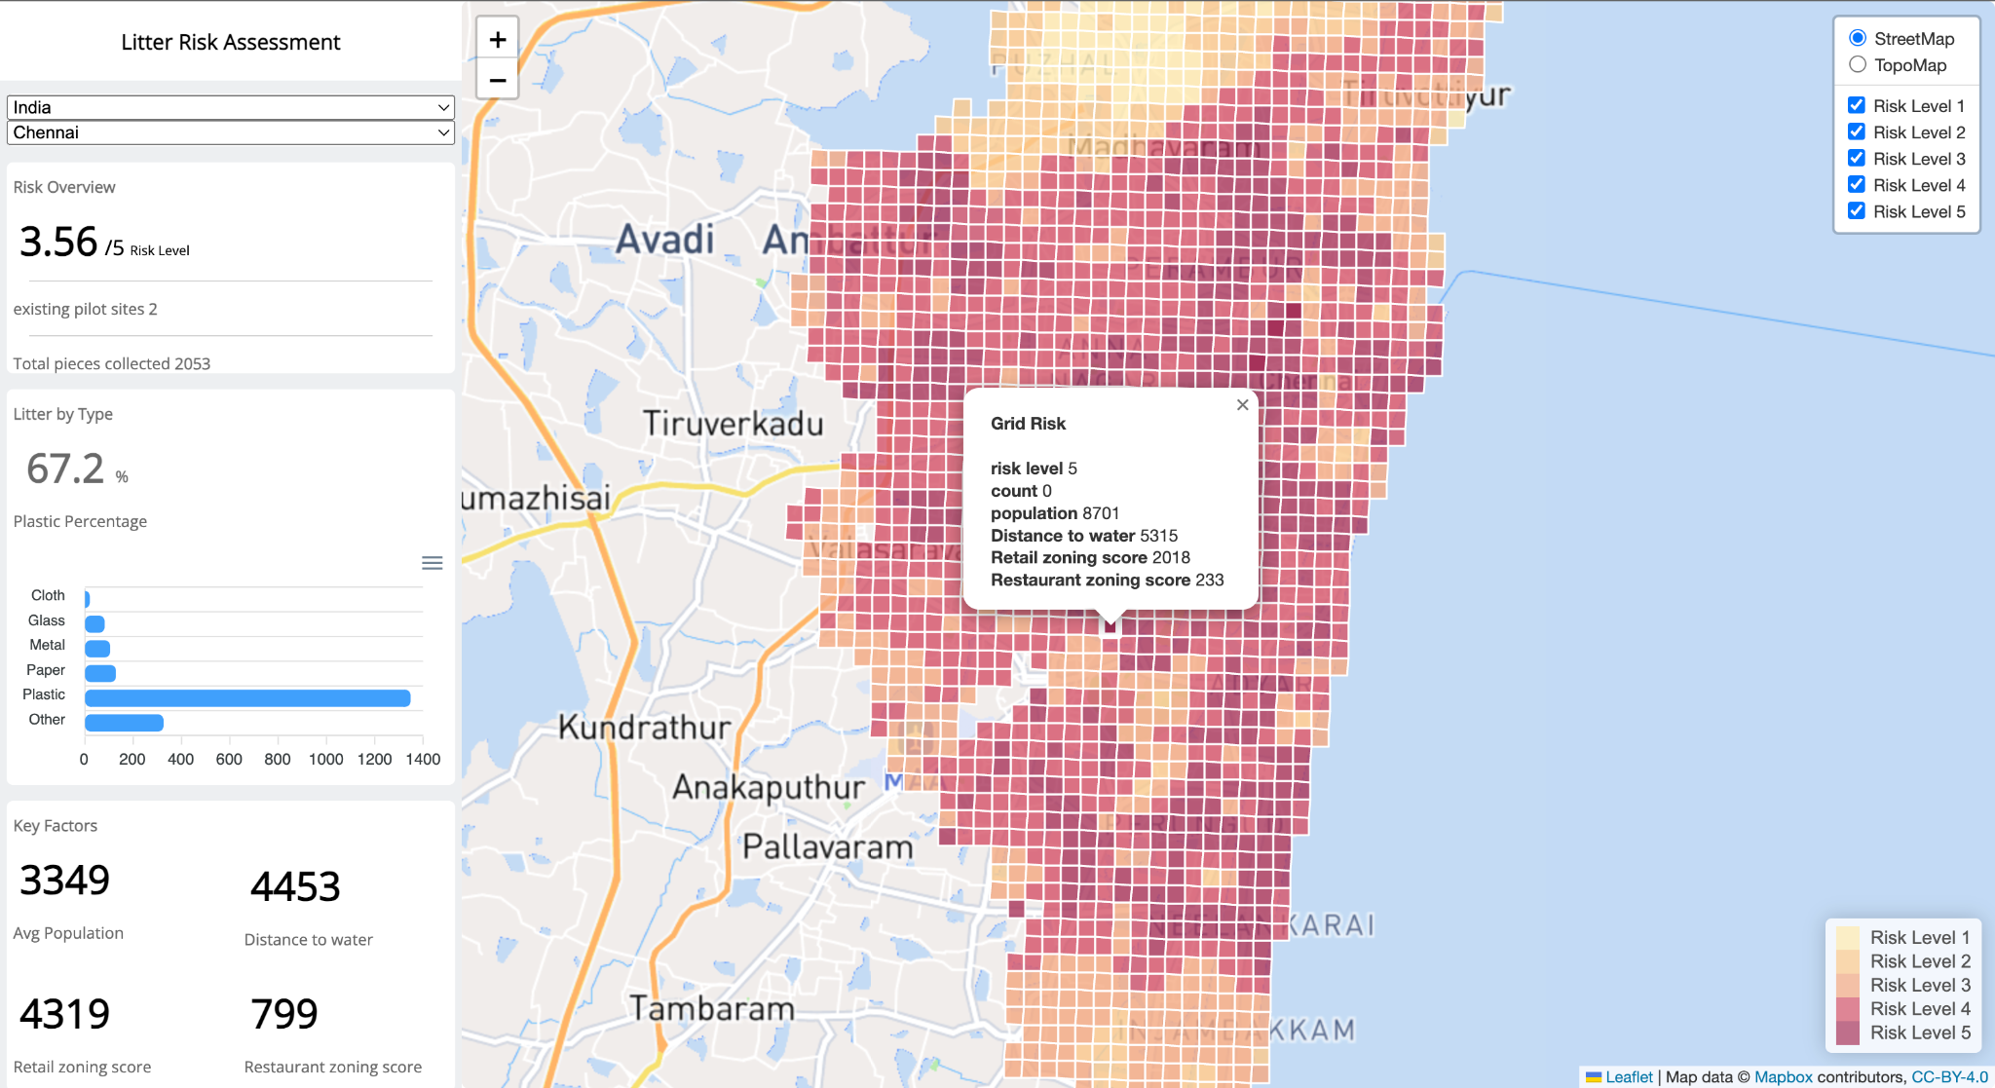
Use Case
A web-based dashboard with litter data metrics, demographic metrics, and a litter accumulation risk site-selection tool serving the 12 urban ocean cities in siting zero-waste pilots.

Slide 9
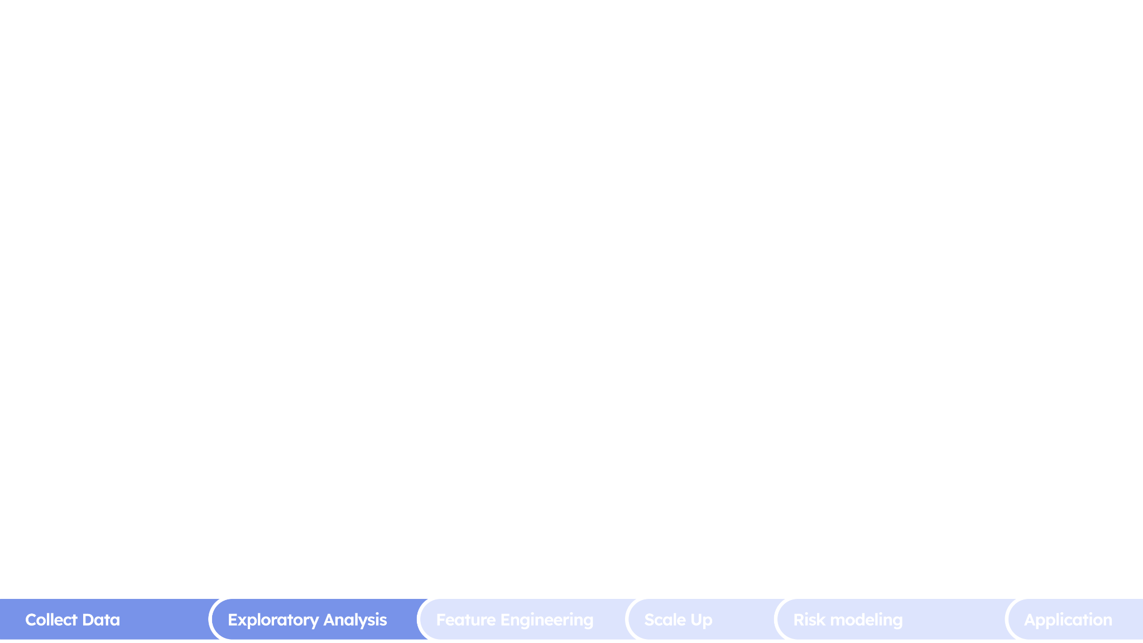
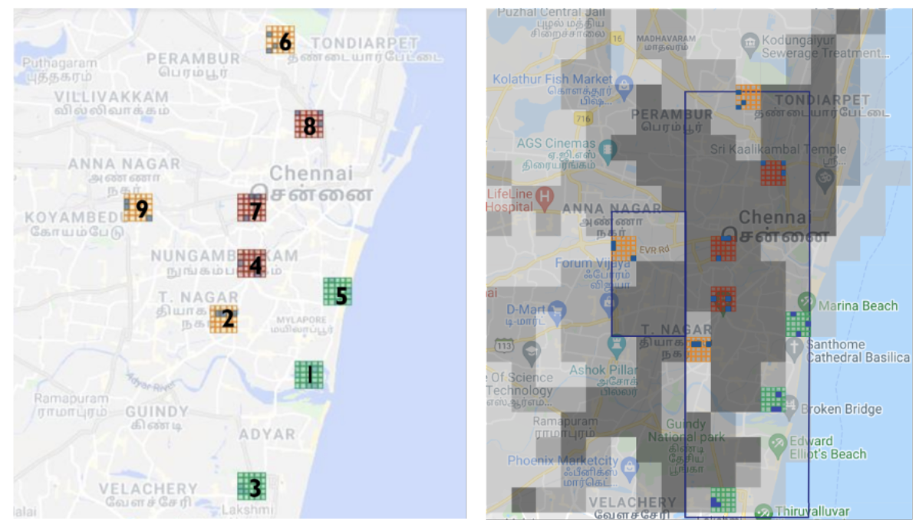
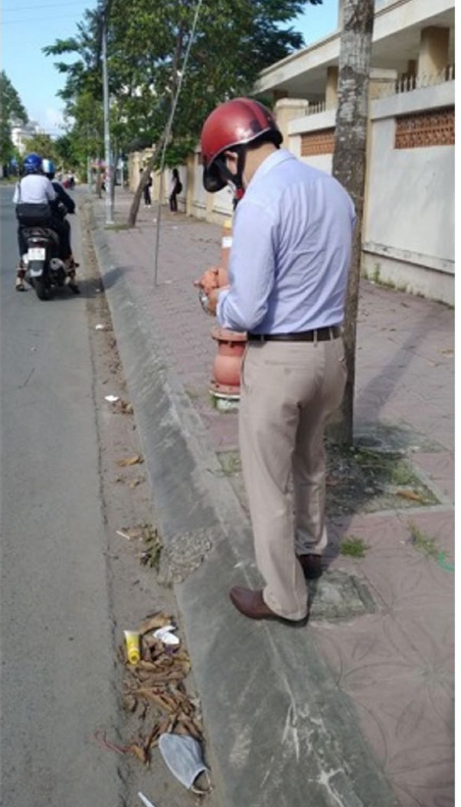
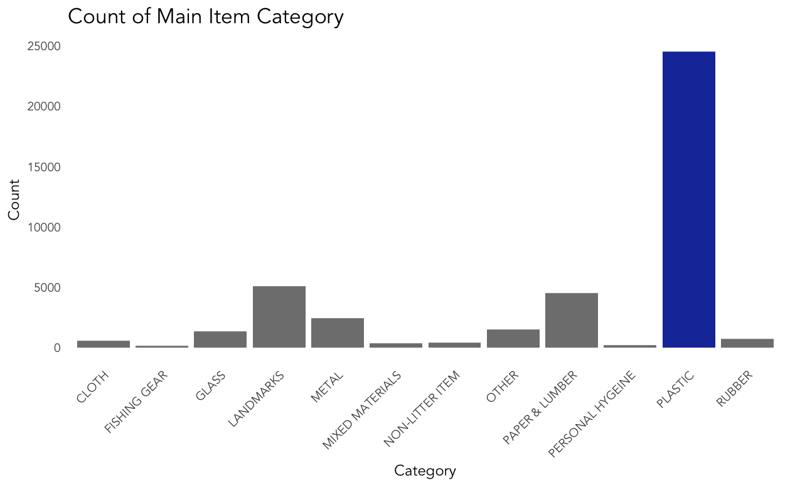
Understanding the Litter Dataset
Manually collected dataset- scarce
Mostly plastics related

Slide 10



The Data Problem
Data: unbalanced across cities
Road blocks…such as
Standardized data across cities missing
Needing international data sources (OSM) and Meta
Minimal data samples
Sampling bias of litter
(Open Street Map)
Non-uniform global datasets

Slide 11
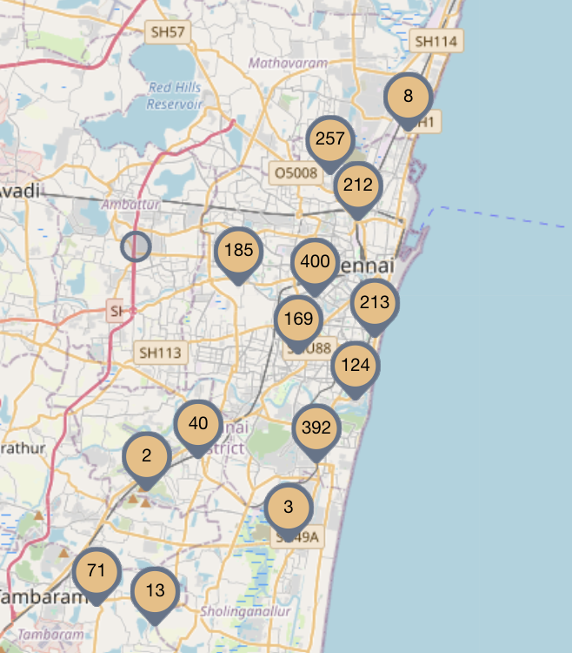
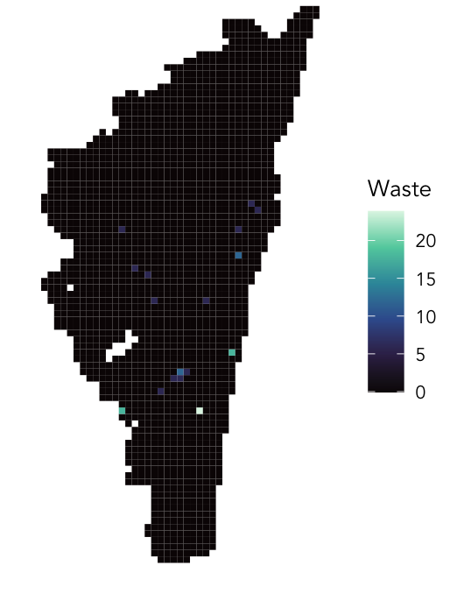

Fishnet Grid Methodology
Sample City
500m fishnet grid
Overlay
Litter distribution
>
>
>

Slide 12
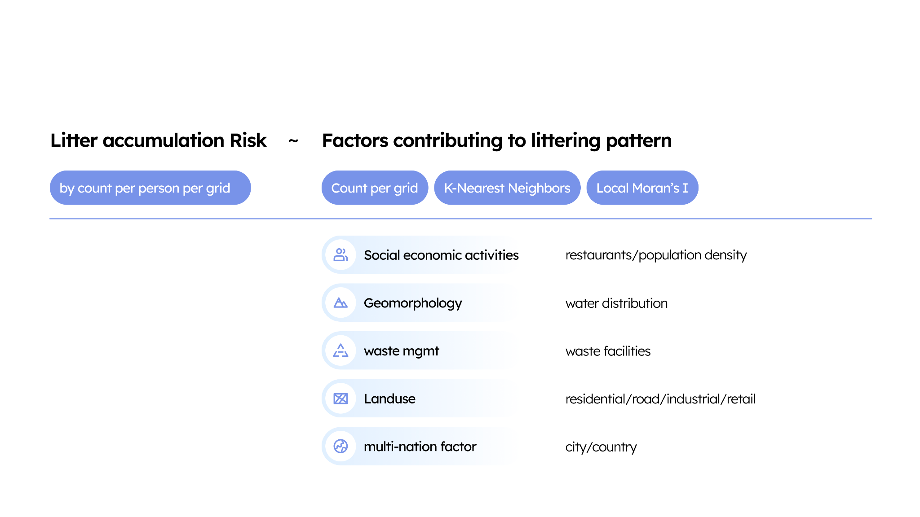

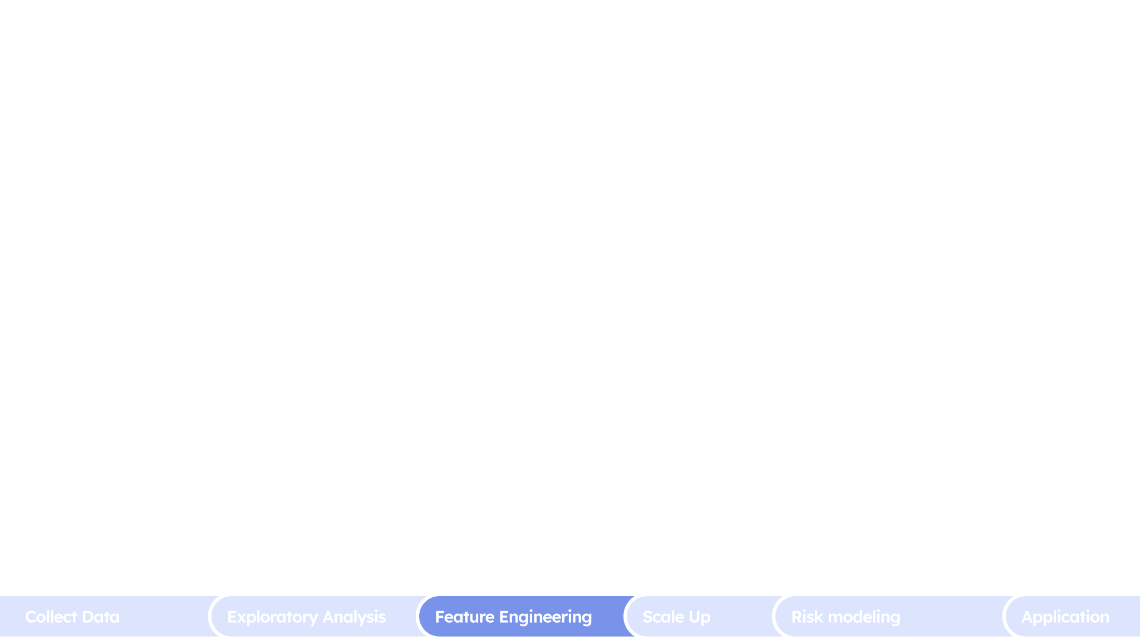
Target Variables

Slide 13

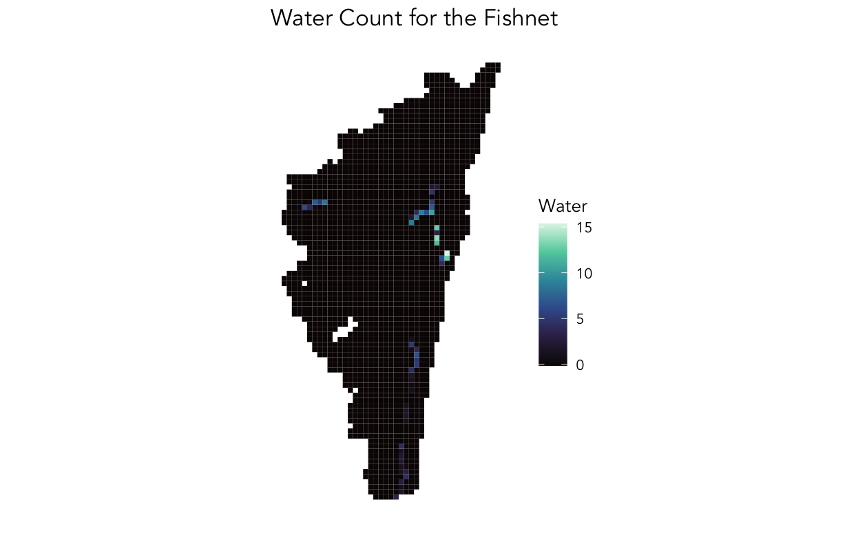
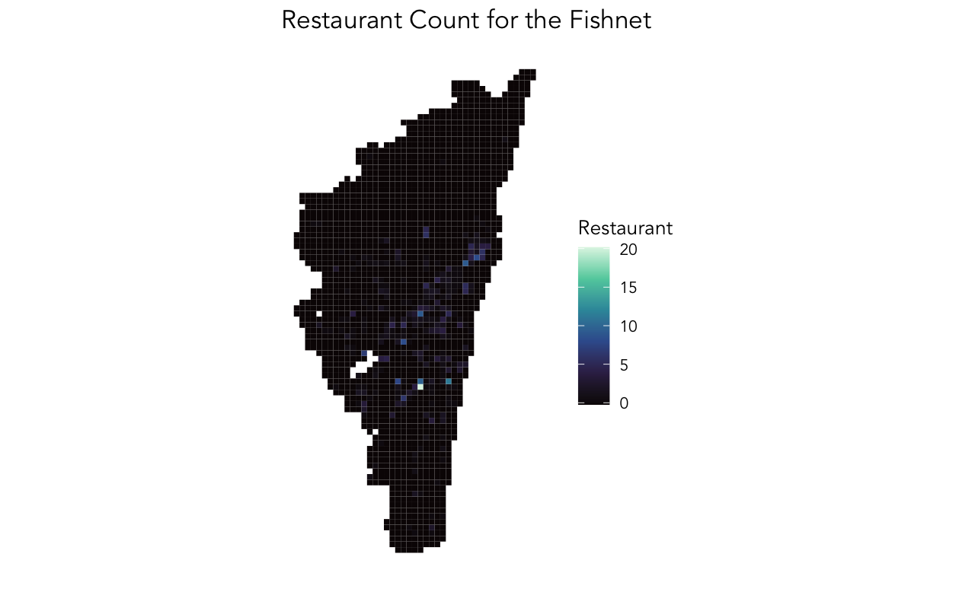
Feature Engineering: Count
Retail Zoning
Water
Restaurant

Slide 14
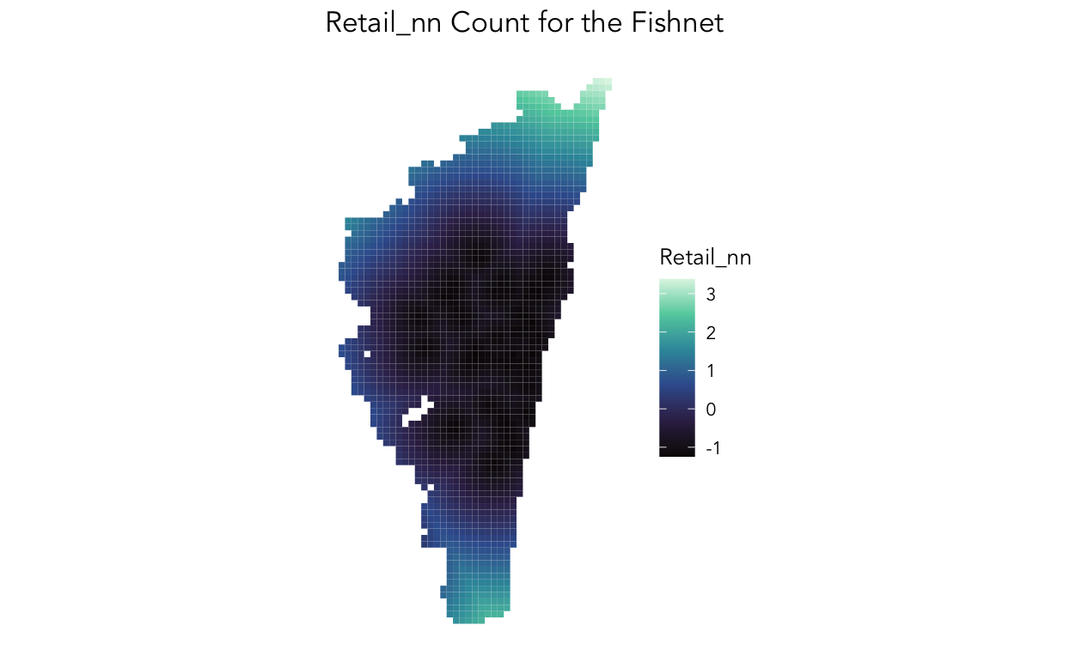
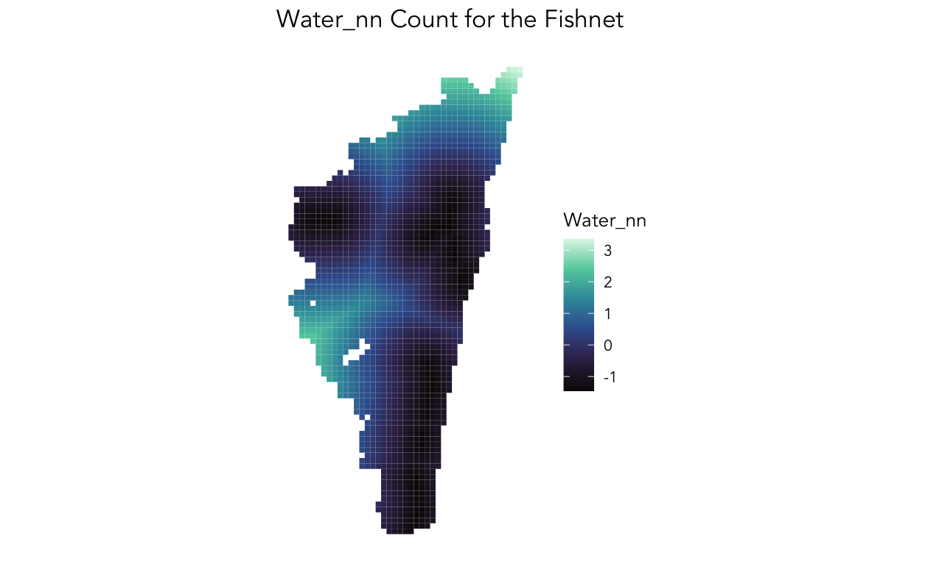
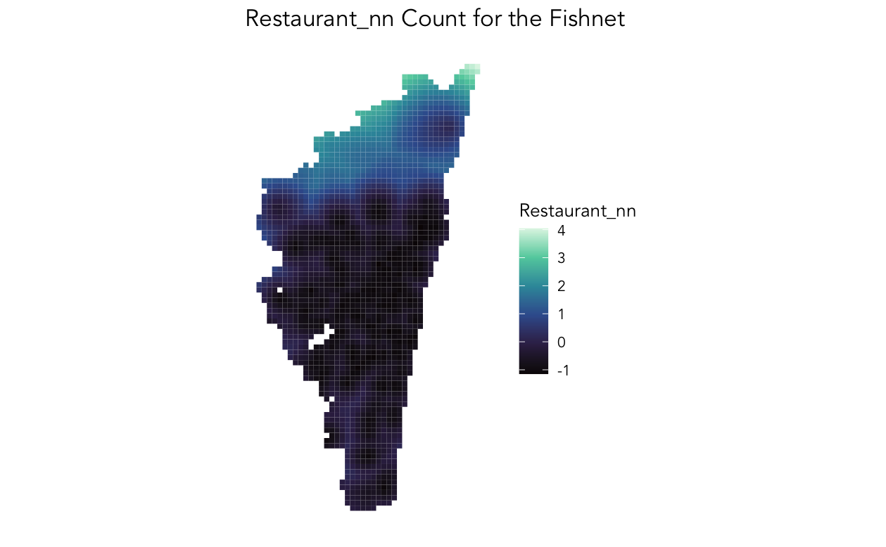
K Nearest Neighbor
Retail Zoning
Water
Restaurant

Slide 15
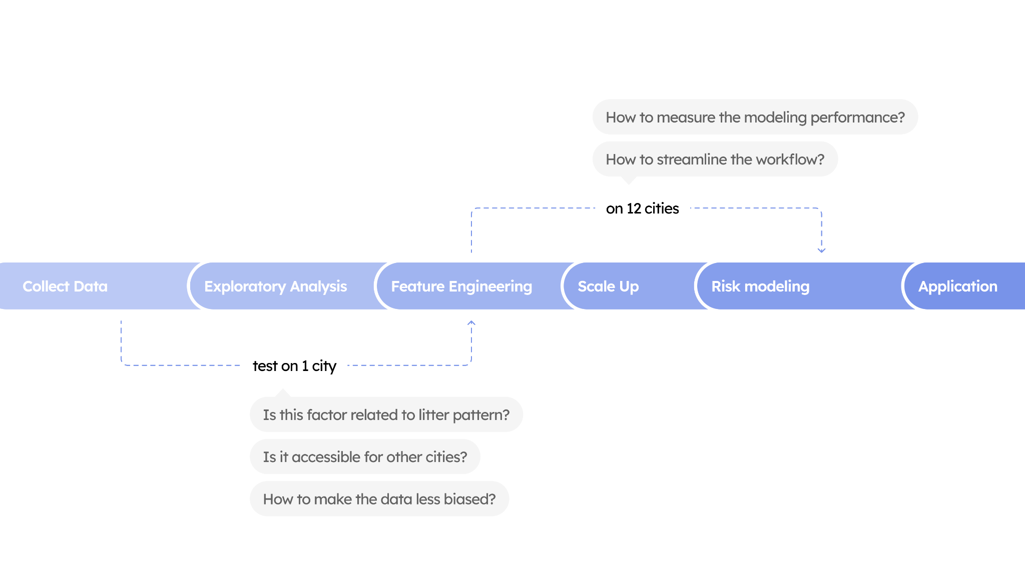
Model Methodology

Slide 16
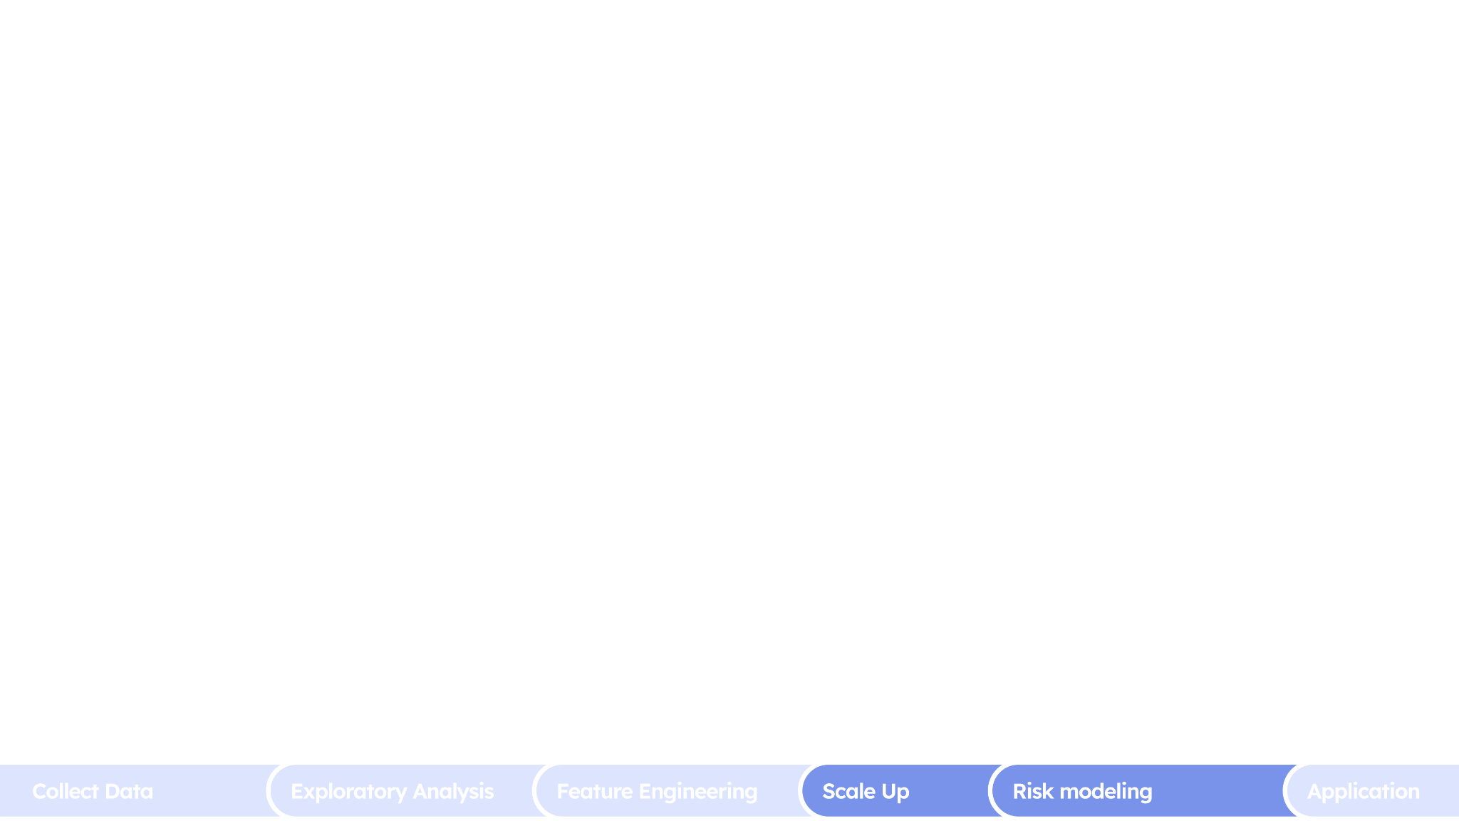
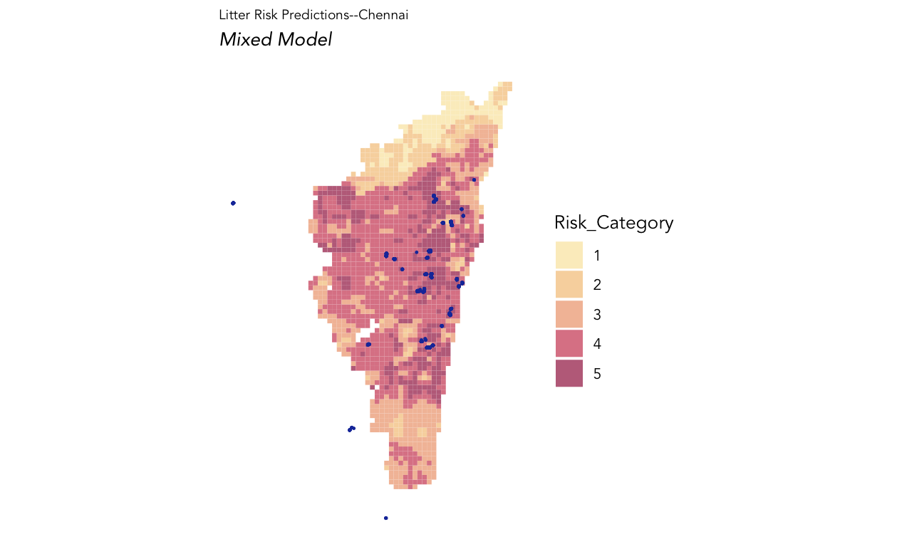
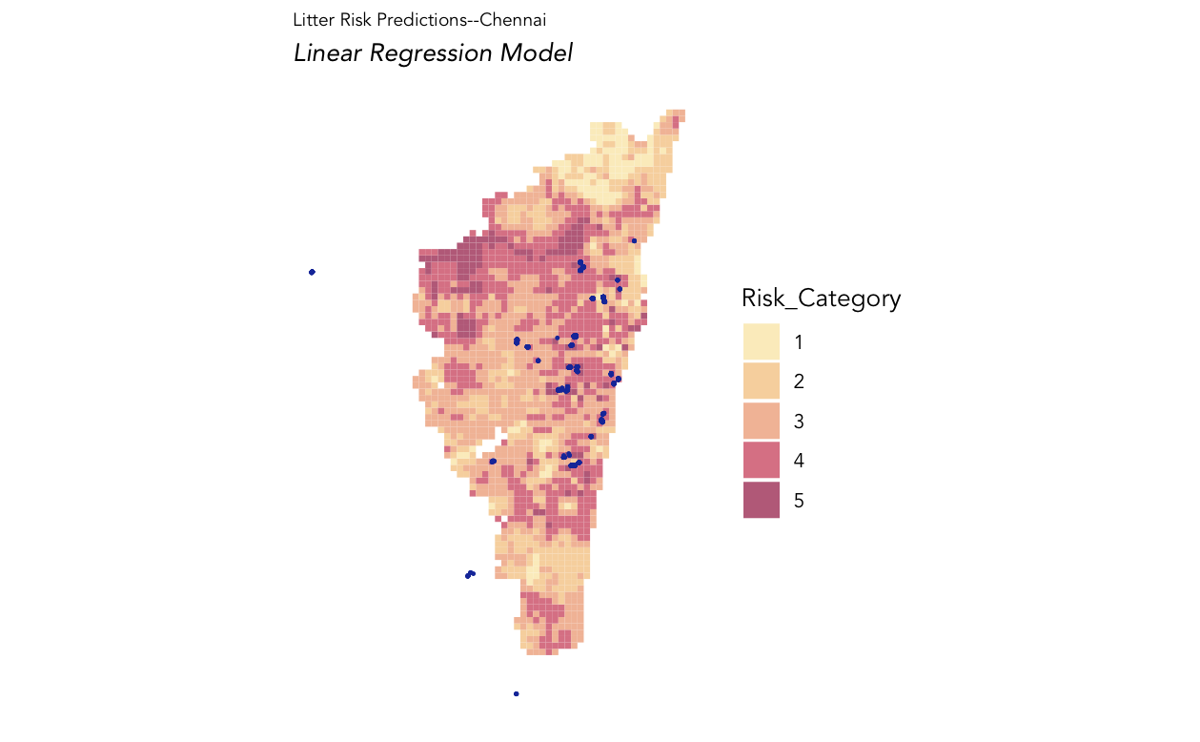
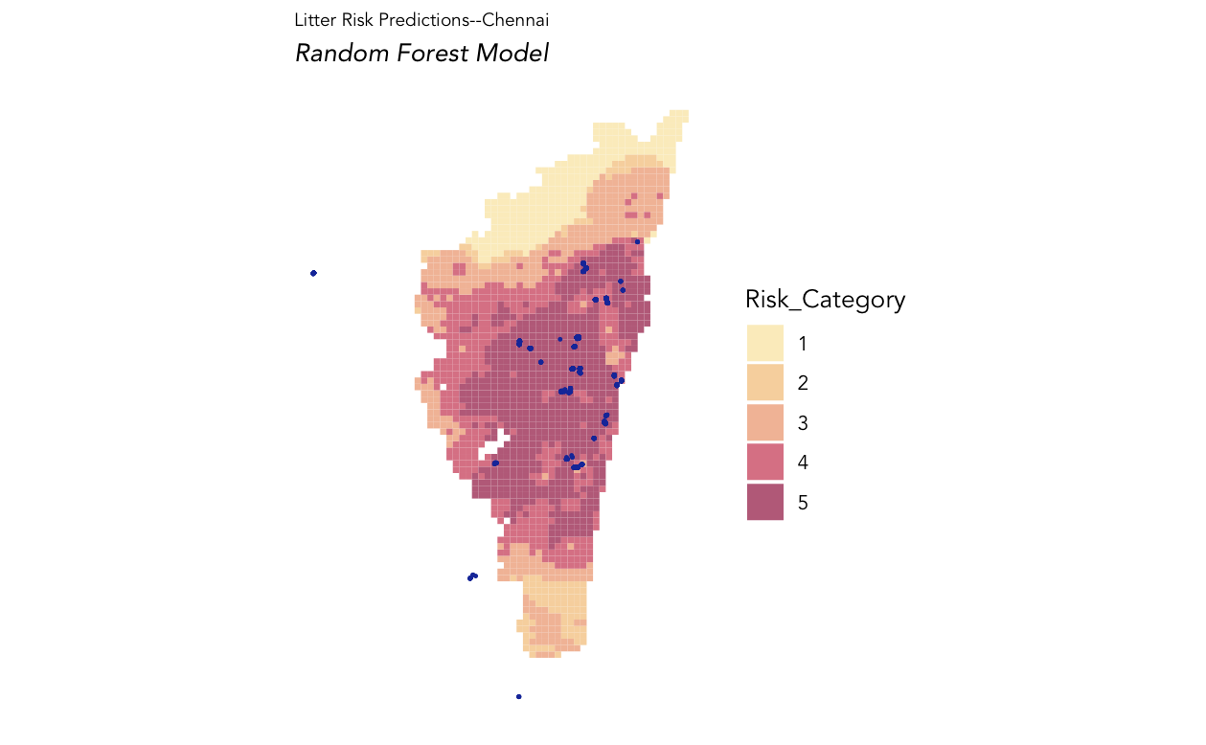
Landing on the best Model
Final Model
(Mixed 60-40)
Model 1
(Linear Regression)
Model 2
(Random Forest)

Slide 17
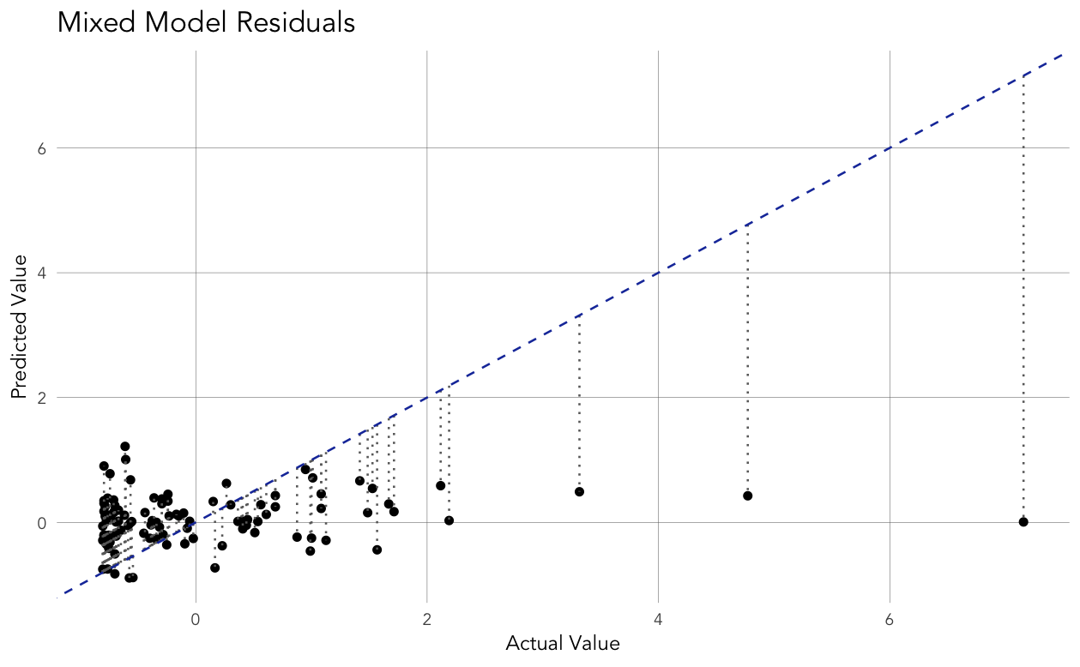
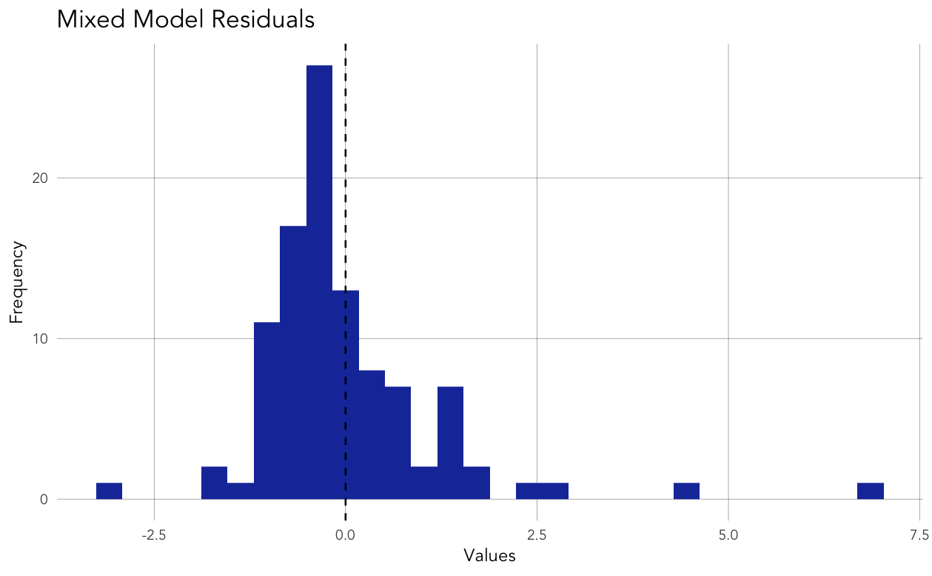
Model Results
Predicted Values vs Actual Values
Histogram of Residuals

Slide 18
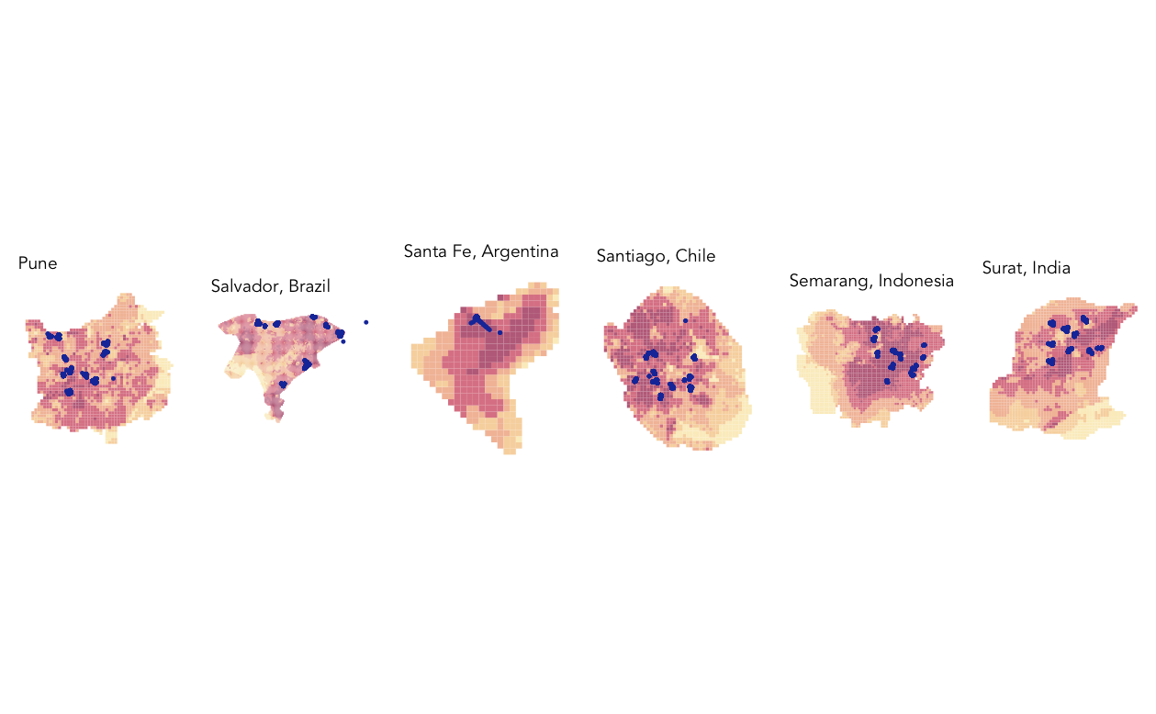
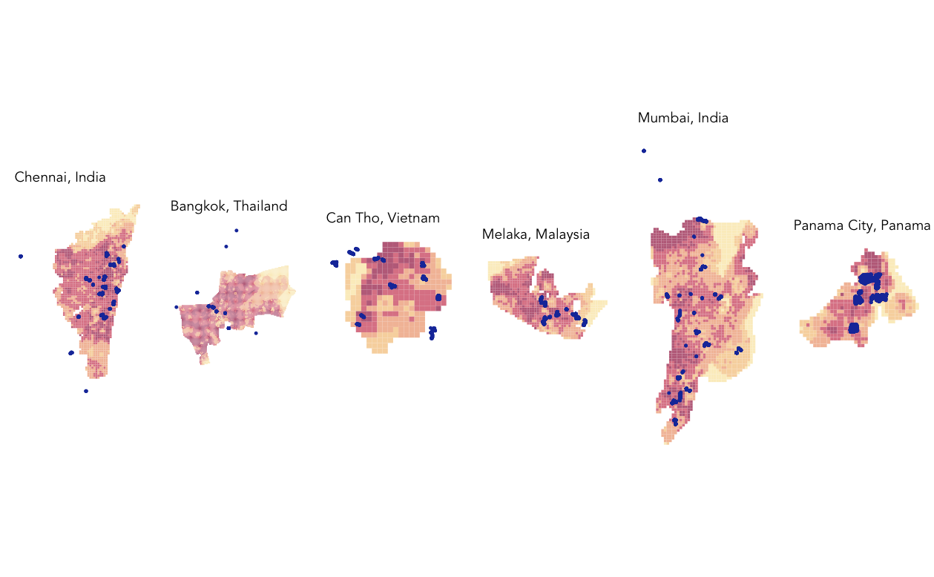

Slide 19
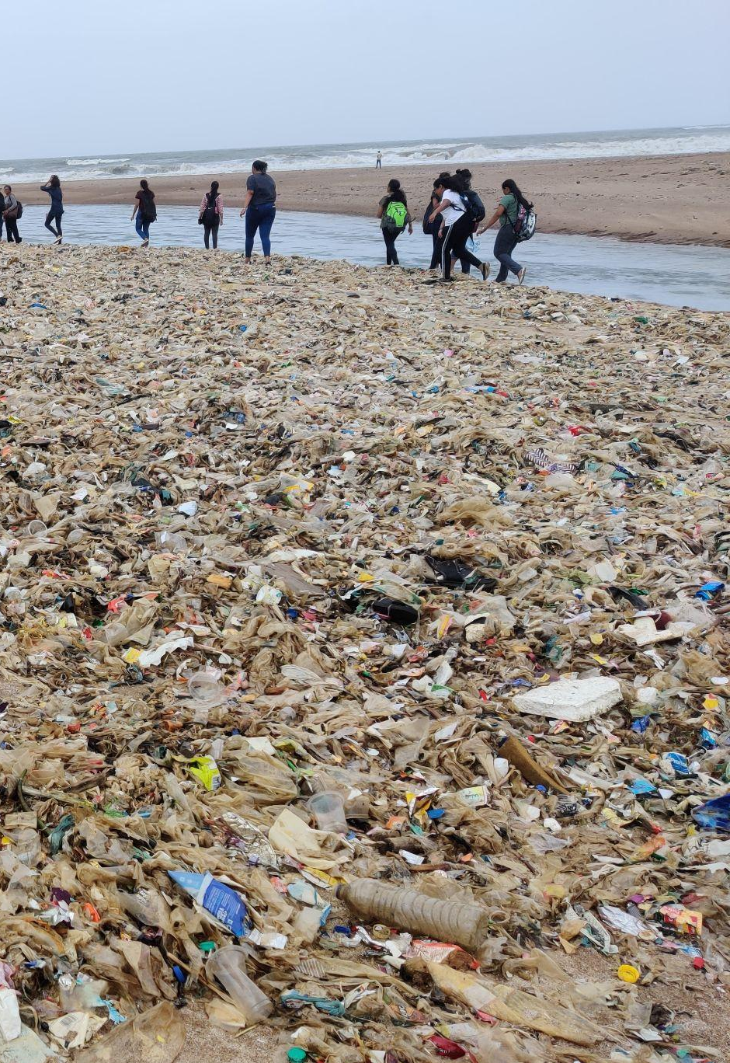
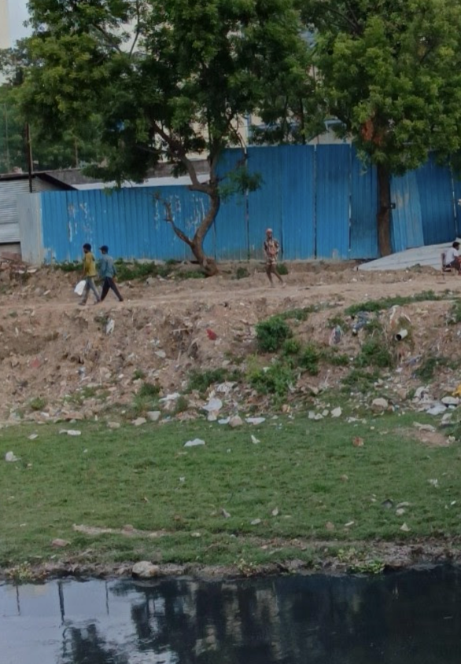
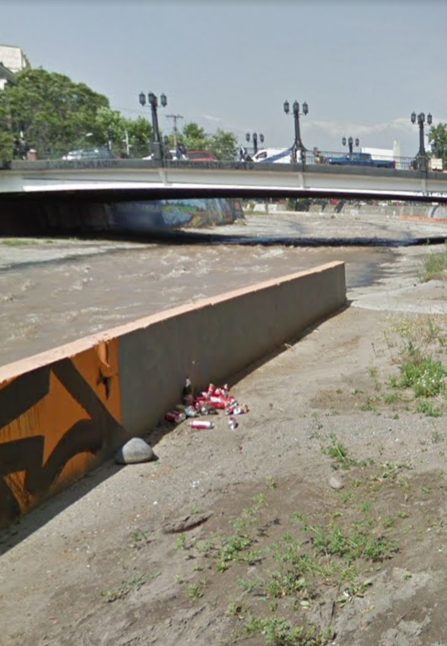
Risk Factor on the ground
5
3
1
Source: Shreya Bansal
Source: Google Street view
Source: Google Street view

Slide 20
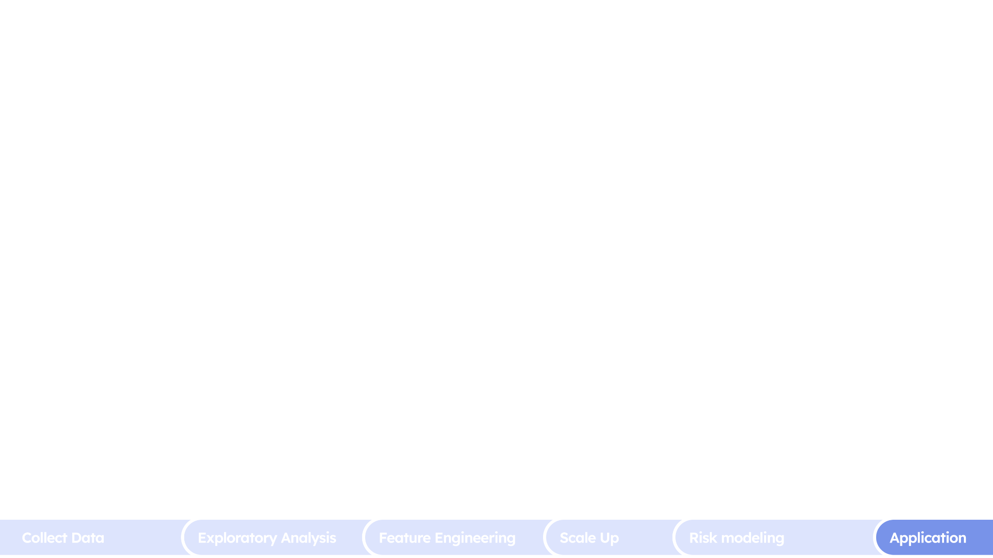
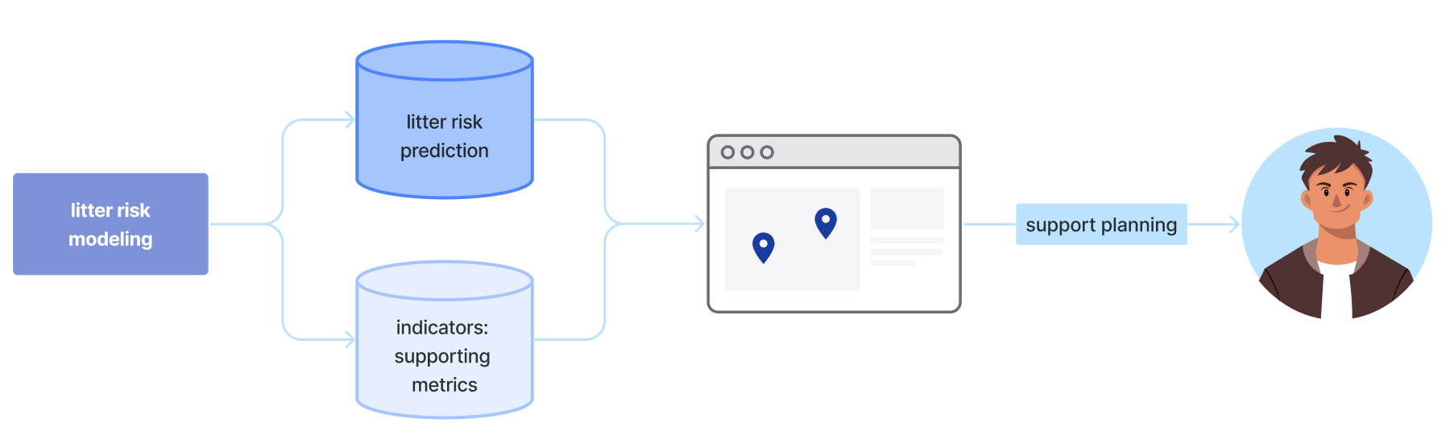
Connection to Use Case

Slide 21
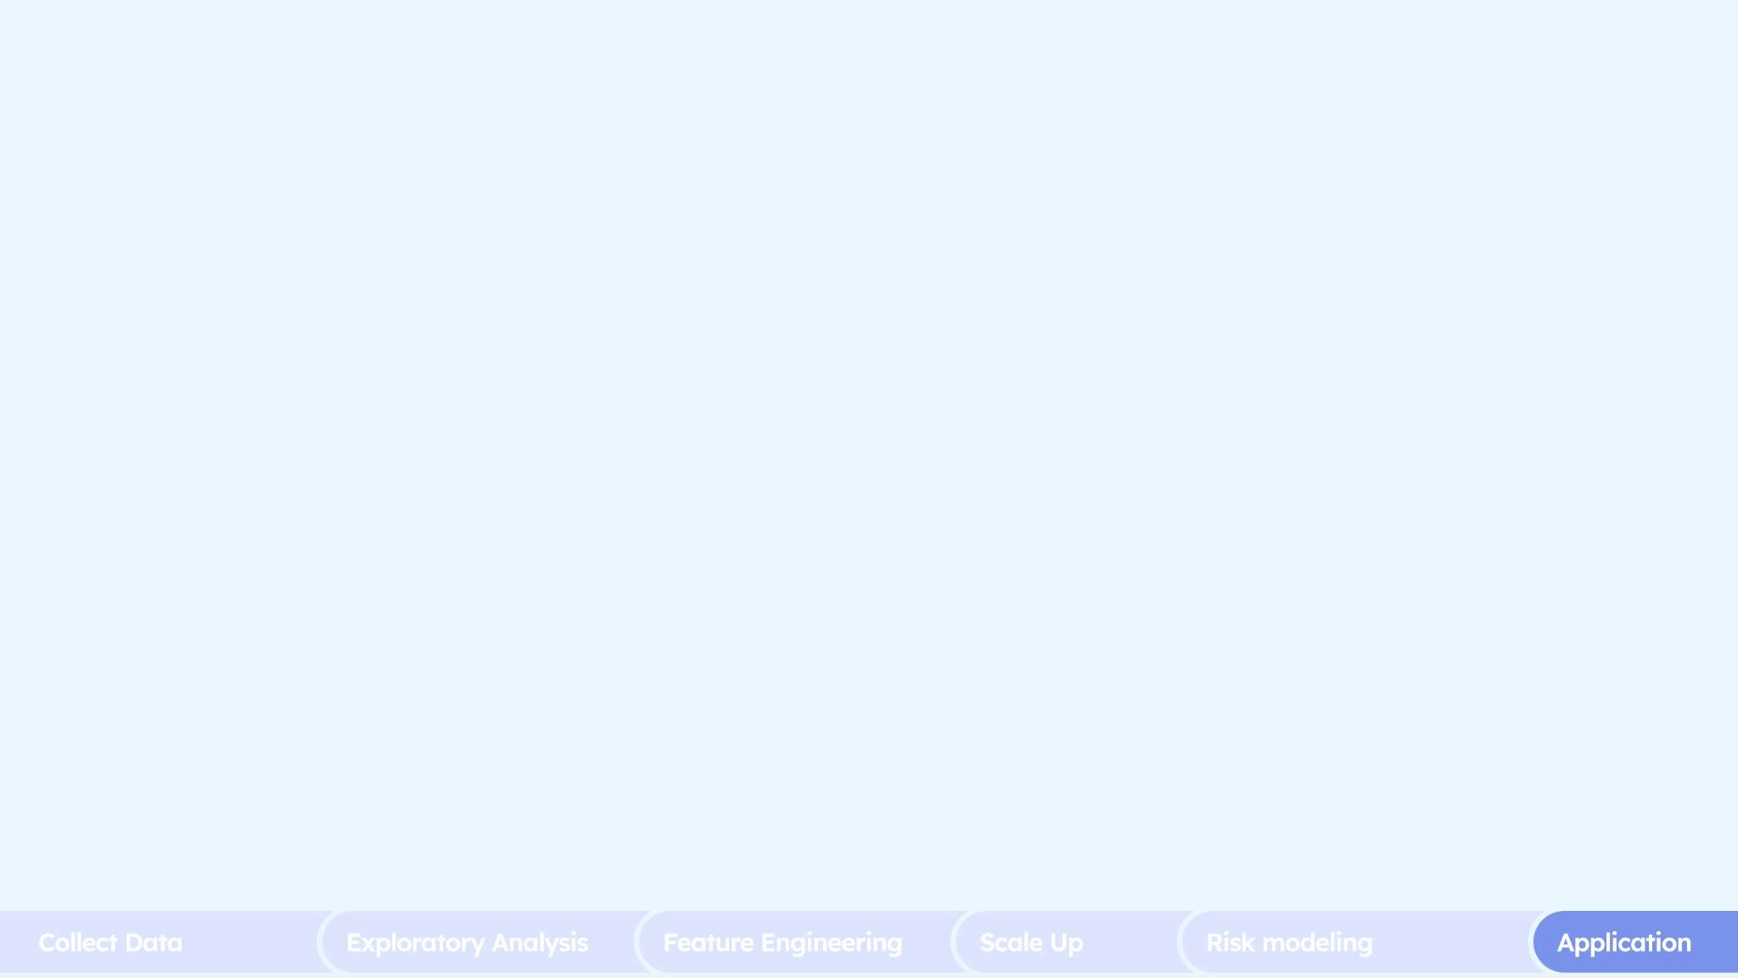
Let’s dive into the marine litter assessment dashboard
https://xxiaofan-98.github.io/Litter-risk-dashboard/

Slide 22
References
Project Director: Daniel Padilla Ochoa
Director, International Plastics Program - Ocean Conservancy: Edith Checchini
University. of Georgia: Prof. Jenna Jambeck, Ph.D.

